Slide 1
The Role of Bahraini Women in Art and Design in The Kingdom of Bahrain
By:
Dr. Janon Kadhim
Ms. Sara Ahmed
Ms. Amna Hassan
College of Art & Design
Royal University for Women
Kingdom of Bahrain
April 2016

Slide 2
Introduction
Traditionally in Bahrain men have been the sole providers for their families
However, in recent years this concept is gradually changing, as the global factors begin to influence Arab and GCC societies, including in the fields of Art and Design.
Many local women artists and designers are pursuing through their work to deliver effective contributions to the community

Slide 3
Problem Statement:
The main research problem is derived from the need to highlight the role and contribution of Bahraini women in the fields of Art and Design in the Kingdom of Bahrain.

Slide 4
Objectives
Explore the role of Bahraini women in the development of the art and design profession in Bahrain by tracing the efforts of the pioneer Bahraini women in the field and their contributions in this realm.
Emphasize the role of governmental and non-governmental entities in providing continuous support to the women of Bahrain to further develop their creative and entrepreneur skills in the field of Art and Design.

Slide 5
Methodology
This study will reflect an analytical approach, including:
Review of publically available material which highlights the role of Bahraini women in art and design
Study of the role of governmental and non- governmental bodies that support Bahraini women artists
Interviews with a number of Bahraini artists

Slide 6
The Scope of the Study
The role of women in a number of creative fields including:
Fine Arts
Fashion Design
Interior Design
Graphic Design
Role of governmental and non-governmental entities in providing support to the women of Bahrain
It also presents the futuristic vision of Bahraini women influencing the field of art and design

Slide 7
Art and Design in Bahrain
Though Bahrain is considered to be a relatively young nation, it is considered one of the first Gulf countries and a leading Arab country in welcoming art.
Painting classes in 1919
Bahrain was the first to open a cinema in 1937
The Bahrain Arts Society was initiated in 1983.

Slide 8
Art and Design in Bahrain
Establishing a number of art galleries:
Al Bareh Art Gallery
Al Riwaq Gallery
Ella Art Gallery
The La Fontaine Centre of Contemporary Art
Nadine Gallery

Slide 9
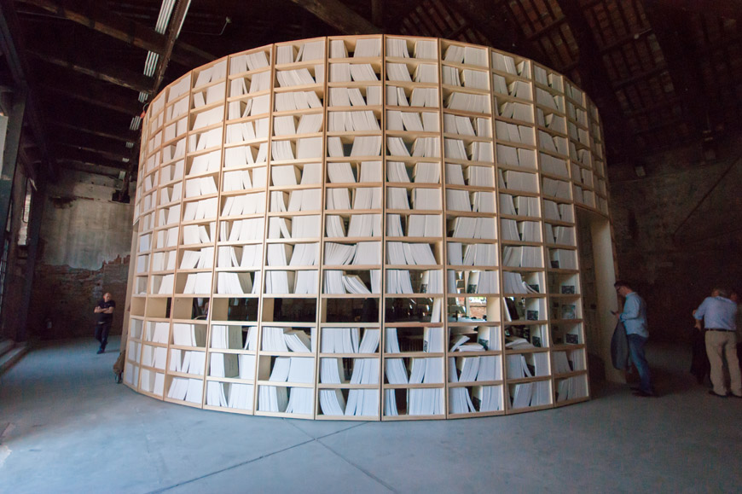
Art and Design in Bahrain
Bahrain won the Gold Model for the Finest National Pavilion at the 14th International Architecture Exhibition La Biennale in Venice
Source of Image: (Lusiardi, n.d.)

Slide 10
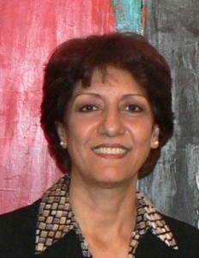
Pioneer Bahraini Artists
Balqees Fakhro
Born in 1950 in Bahrain
Graduate from Lone Mountain College in San Francisco with a Bachelor of Arts degree
The first Woman member of the Bahrain Art Society.
Known for her colorful abstracts.
Source of Image:
Members of The Bahrain, n.d.

Slide 11
Balqees Fakhro
Source of Image: Art Gallery, n.d.

Slide 12
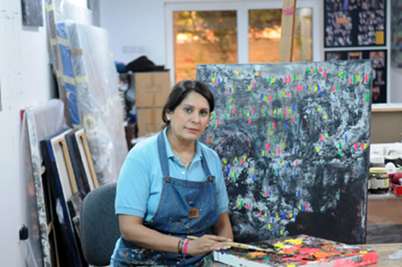
Pioneer Bahraini Artists
Faika Al Hassan
An economics graduate who took private painting lessons in Bahrain and Lebanon.
Known for her inspirational abstract urban landscapes of Bahrain.
Her art reached Dubai, Madrid, Damascus, Brussels and Luxemburg, where she actively contributed in a number of solo and group exhibitions
Faika was granted Bahrain Fine Exhibition Award in 2007 at
Al Saafa Prize for Fine Art at the GCC in 2009
Source of Image: ArtBahrain in Conversation, 2012

Slide 13
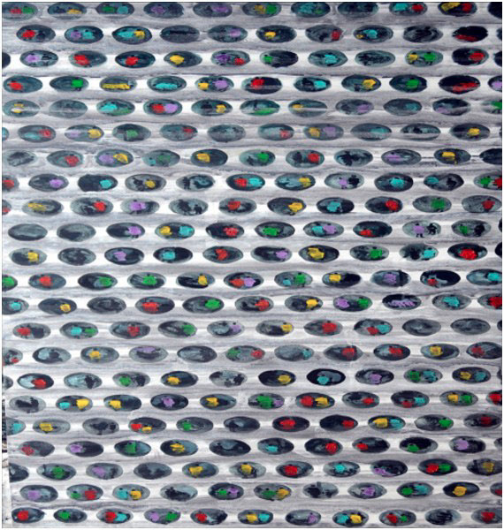
Faika Al Hassan
Source of Image: Akkermans, n.d

Slide 14
Bahraini Women in the Fine Arts
Mariam Haji Al Janahi
Bachelor of Fine Arts from Royal Melbourne Institute of Technology.
Diverse mediums varying between painting and drawing to performance and video.
Exhibitions in Sweden, Dubai, Cairo, Amman, Paris and Melbourne.
Represented Bahrain in 2008 in Melbourne at the Frankston Art Centre and in 2013 at the 55th Venice Biennale.
Source of Image: Stafford, 2013

Slide 15
Bahraini Women in the Fine Arts
Mariam received an international recognition after winning in Bahrain’s 38th National Exhibition of Fine Arts, with her famous series “Kill the Muse”
Source of Image: Stafford, 2013

Slide 16
Bahraini Women in Interior Design
Ghada Al Sayed
May be considered a Pioneer Woman Interior Designer in Bahrain.
Founder of Horizon Interiors introduced in 1996.
Master Degree in Business Administration, a Bachelor Degree in Interior design and a Bachelor Degree in Computer Science.
Source of Image: Facebook, 2011

Slide 17
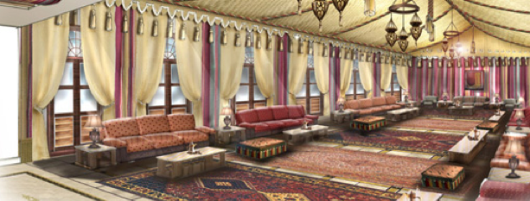
Ghada Al Sayed
Source of Image: Horizon Interiors, 2008

Slide 18
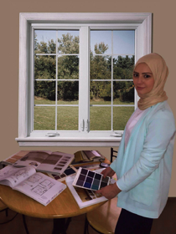
Bahraini Women in Interior Design
Maryam Khalid Al Awadhi
A young Bahraini Interior Designer.
She introduced Rooms BH in 2015.
She manages her company alone and collaborates with other freelance designers when needed.
Received financial support through Tamkeen.
Source of Image: Room Bahrain, 2015

Slide 19
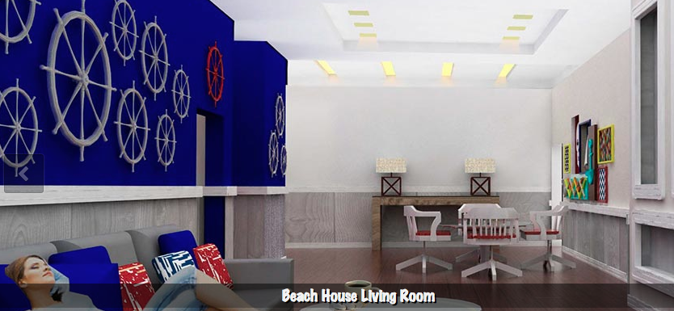
Maryam Khalid Al Awadhi
Source of Image: Room Bahrain, 2015

Slide 20
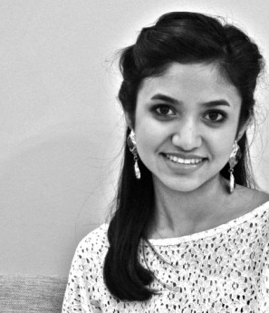
Bahraini Women in Fashion Design
Amal Al Mulla
A Royal University for Women alumnae.
In 2012, she established a label name that emphasizes on connecting contemporary fashion with luxurious standards
Amal owns a studio in Bahrain where all productions are processed
Source of Image: Alothman, 2012

Slide 21
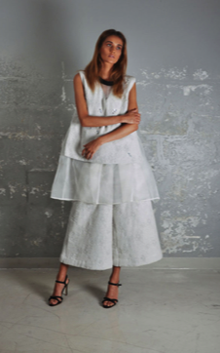
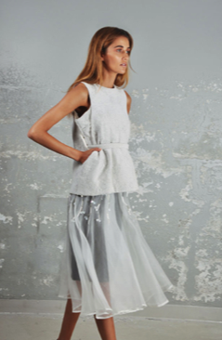
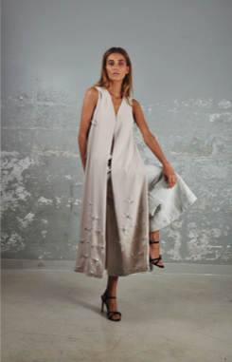
Amal Al Mulla
Source of Image: Fall Winter 2015, n.d.

Slide 22
Bahraini Women in Fashion Design
Noor Rashid Al Khalifa and Haya Mohammed Al Khalifa
Founders of Noon by Noor, luxurious women swear label essentially derived by both Western and Eastern influences
Earned a bachelor’s degree in Fashion Design from Washington University
International brand that soon enough developed into an entrepreneurial business
Source of image: Designers of Noon, n.d.

Slide 23
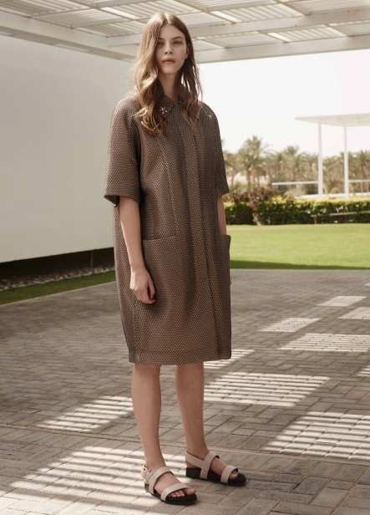
Noon by Noor
International Achievements:
In July 2011 in Los Angeles, founders of Noon by Noor arranged an exclusive event to internationally launch the brand
2012 New York Fashion Week
They sell to Saks Fifth Avenue in both Bahrain and Kuwait, Harvey Nichols in Kuwait, Symphony Style and Per Lei Couture in Doha, as well their online boutique that eases shipping worldwide
Source of image: Resort 2016, n.d.

Slide 24
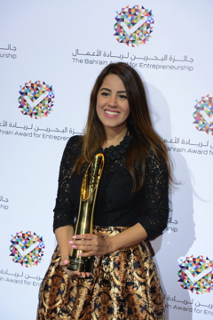
Bahraini Women in Graphic Design
Wafa Al Obaidat
CEO and creative Director of Obai and Hill.
Graduated with a Bachelor Degree in Interior and Spatial Design from Chelsea College of Art and Design at the University of the Arts in London.
She established Obai and Hill in 2010 after her online magazine ‘Sketchbook Magazine’ became very popular in the U.K.
Source of Image: Room Bahrain,2015

Slide 25
Wafa Al Obaidat
In 2015, she received the Start Up of the Year Award.
She also became a committee member of the SME society in the Bahrain Chamber of Commerce.
Obai and Hill also participated in a competition hosted by Arab Architects Institute and Network for a logo design and won the competition (Awards, 2016).
Source of Image: About, 2016)

Slide 26
Bahraini Women in Graphic Design
Manal Qamber
is a freelance graphic designer
Graduated from the University College of Bahrain earning a Bachelor Degree in Graphic Design.
She then started her own career by promoting herself through social media
Source of Image: Facebook, 2009

Slide 27
Role of Governmental and Non-Governmental Entities
The Supreme Council for women:
Established in 2001
Reference for women’s affairs to all official organizations
This council views and decides on issues related to the status of women in Bahrain.
Her Royal Highness Princess Sabeeka Bint Ibrahim Al Khalifa chairs the council.

Slide 28
Role of Governmental and Non-Governmental Entities
The council has three different programs that support women, which include:
Economic Empowerment Program
* Incubators
* Tamkeen
* Ebdaa Bank to help and encourage women to start a home business or to develop an existing business through micro-financing loans.
Political Empowerment Program
Family Stability Program

Slide 29
Role of Governmental and Non-Governmental Entities
The government of Bahrain also provides support to all young Bahrainis who are seeking to start their own business by launching a SME toolkit;
An online platform that helps entrepreneurs and SME’s
They provide self-learning content, business guides, schemes of assistance, updates on government policies, regulations, rules and guidelines.
It is a free toolkit that only requires individuals to register and receive newsletters, notifications about new tools, promoting businesses for free by listing and constructing a webpage of your SME. (SME toolkit Bahrain, 2016)

Slide 30
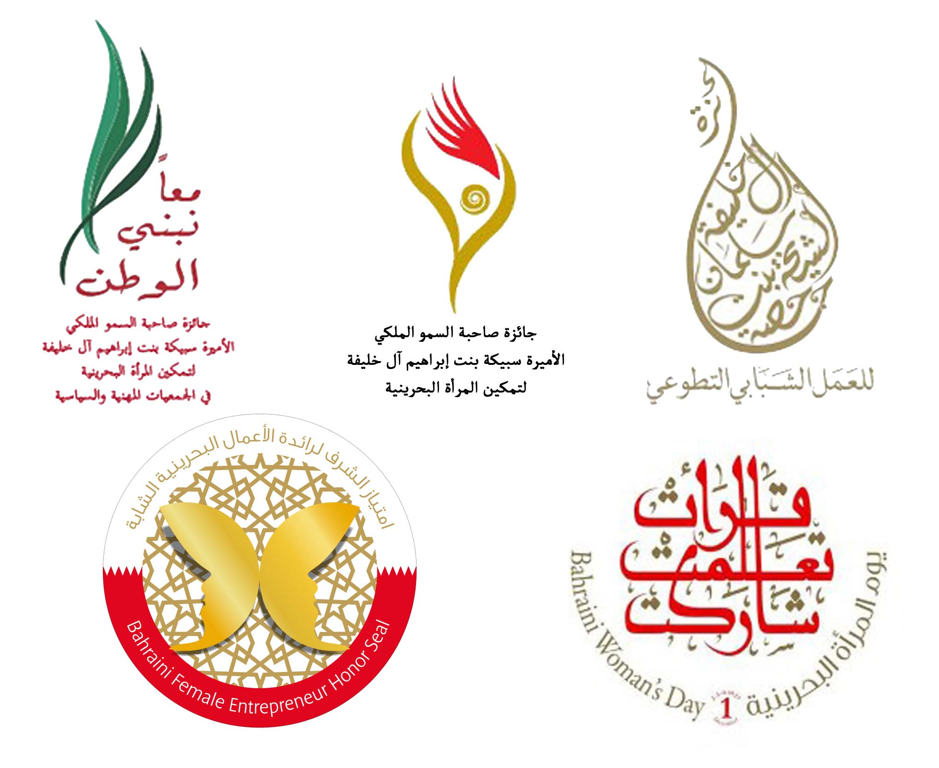
Awards
Source of Image: The Supreme Council for Women, 2015)

Slide 31
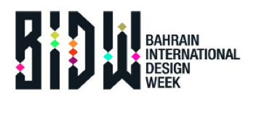
Awards
Source of Image: Bahrain Award for Entrepreneurship, 2015

Slide 32
Significance of Bahraini Women’s Contributions in Art and Design
Positive impacts
Reflecting a creative image of the Kingdom of Bahrain abroad
Influence tourists, which will develop the country’s economy.
Socially communicate with others from different times, cultures and backgrounds.
Appreciate different historical periods and understand their importance to the world.

Slide 33
Futuristic Vision of Bahraini Women in Art and Design
Talent turned into global success
Women are becoming independent individuals
In fact, talent will evolve in becoming a lifestyle to many women Bahraini designers.
The future will be very bright due to the education women in Bahrain receive.

Slide 34
Conclusion
The research shows only a partial part of women’s contribution to art and design in the Kingdom of Bahrain.
The government of Bahrain plays a huge role in supporting Bahraini women in all fields in particular the Supreme Council for Women
Moreover, different awards that motivate designer to work harder.

Slide 35
Thank you

